Slide 1
AI Contract
Orange Team:
Aiden Green, Catherine Bickerton, Jay Scott, Luke Robinson

Slide 2
System Metaphor
The Office of Sponsored Programs at Auburn University reviews all potential external contracts, proposals, and awards to determine whether the university can negotiate or approve them. Staff members are currently required to review each contract manually, which is time-consuming, arduous, and inefficient. Our team’s goal is to design an artificial intelligence program that reviews all incoming contracts, flags conflicts within them, and suggests alternative wording in accordance with the university’s guidelines. This program will streamline the contract review process for OSP staff members and learn from successful contract negotiations to strengthen its functionality.

Slide 3
Cycle Intent
The objective of this architectural spike is to review previous designs of this software created by other Senior Design teams and determine the optimal approach going forward this semester. The team intends to improve on prior implementations and transform the current AI contract program into a more reliable and robust software. Team members familiarized themselves with the preexisting code and created a demo of last semester’s work. In addition, team members also completed a short AI parsing project from Harvard University’s CS50 Introduction to AI online course to get valuable insight on how to potentially improve the parsing program.

Slide 4
User Story #1: Document Scanning
Summary: As a contract reviewer I want a tool that scans agreements to find problematic language to increase the speed at which my department operates.
Description: This feature should scan an agreement and search for problematic language and clauses that are not acceptable. The scanned agreement should be compared to the FAR Matrix and Contract T&Cs Matrix to flag these issues for review or removal.
Planned Hours: 12
Planned this cycle: 12
Actual: 3
Actual this cycle: 3
Coders: N/A
Testers: N/A
Reviewers: N/A
Status: Not started

Slide 5
User Story #2: Suggest Alternative Language
Summary: As a contract reviewer I want a tool that can suggest alternative language for the problematic language that has been flagged instead of having to manually search for it.
Description: This feature should use approved AU alternative language documents to suggest alternative language to a document reviewer when encountering flagged problematic language and clauses.
Planned Hours: 15
Planned this cycle: 5
Actual: 0
Actual this cycle: 0
Coders: N/A
Testers: N/A
Reviewers: N/A
Status: Not started

Slide 6
User Story #3: Learning from Negotiations
Summary: As a contract reviewer I want a tool that can learn from past negotiations and provide better and more accurate suggestions to more quickly and consistently lead to successful negotiations.
Description: This feature should retain information gained from past negotiations and learn from its successes and failures to improve performance in the future. (There are many instances where the same types of negotiations have to be made with the same companies, this will allow some steps to be skipped, thus saving time.)
Planned Hours: 30
Planned this cycle: 0
Actual: 0
Actual this cycle: 0
Coders: N/A
Testers: N/A
Reviewers: N/A
Status: Not started

Slide 7
User Story #4: Risk Assessment
Summary: As a contract reviewer I want a tool that will give me an overall risk rating for a contract so I can make appropriate risk assessments during a negotiation.
Description: This feature should take into account all risk factors for a given contract and provide past relevant information to assist reviewers in a manual risk assessment. This will be useful when the negotiations do not follow a typical format.
Planned Hours: 40
Planned this cycle: 0
Actual: 0
Actual this cycle: 0
Coders: N/A
Testers: N/A
Reviewers: N/A
Status: Not started

Slide 8
Design Documentation #1: Language
We are the second semester of students assigned to this project and all of the existing code-base is written in Python. We have all decided that it will be easiest to remain with this language, as we are all confident in our Python knowledge. Python also has many readily available machine learning libraries, such as scikit-learn, that we can make use of for the more complicated portions of this project.

Slide 9
Design Documentation #2: Architecture
This project will take in the text of a given document and process it in many different ways to speed up the contract review process. Currently (for a simplified layout description), there is a simple GUI where the user can select a desired document, save it, and then scan it. When the user selects the ‘scan’ option the main operation of the script begins, which is as follows: the contract is converted to a .txt file (this makes the document easier to deal with), the script to flag problem language is then ran (using the FAR Clause Matrix and T&Cs Matrix that load on GUI open), the scanned contract is then converted back to a docx file, and then the contract is annotated when back in its original state.

Slide 10
Meeting Minutes
The team met 2 times before the end of the spike, once in person with both the client and the blue team and once through Discord calls and messages.
Client Meeting (01/23/2024)
Darren May, our client, gave an in-depth explanation of the current state of the project as well as his desired deliverables for the end of the semester. The combined teams decided to work together on the software rather than compete with each other so that more progress can be made toward achieving the client’s goals.
Discord Meetings (01/25/2024 - 01/29/2024)
The orange team met in discord meetings to allocate work related to the spike to individual members and complete the required deliverables.

Slide 11
Lessons Learned
Team Collaboration: Identified areas of improvement in terms of team communication and time-management
Technical Understanding: Identified steep learning curves and began to identify how to overcome them
Understanding Research Contracts: Delved into the world of the terms, conditions, and regulations our model must consider in its analysis
Continuous Learning: We understand that while we have already learned so much, the need to learn will only grow

Slide 12
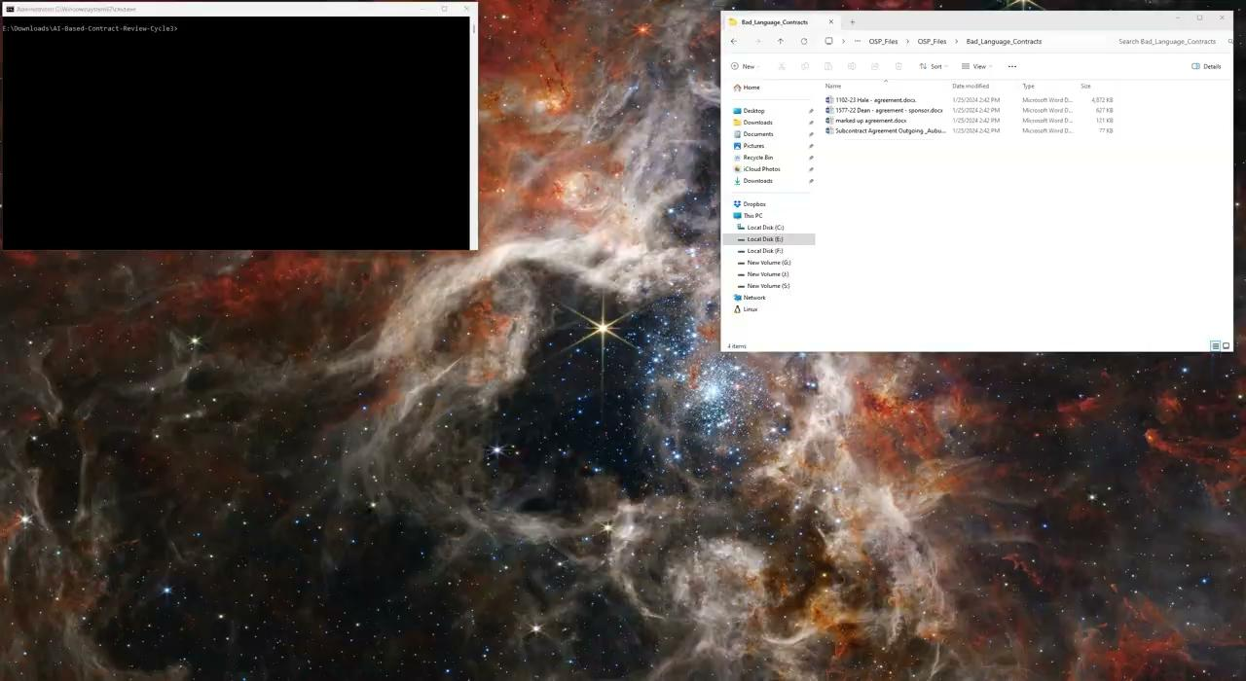
Demo

Slide 13

AI Parsing Project

